Slide 1
Early Detection of Parkinson’s Disease Using Machine Learning Techniques
COS6032-E Industry AI Project

Slide 2
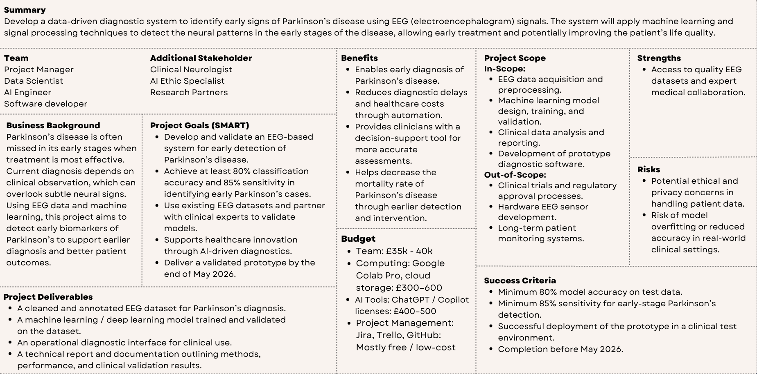
Project Charter :

Slide 3
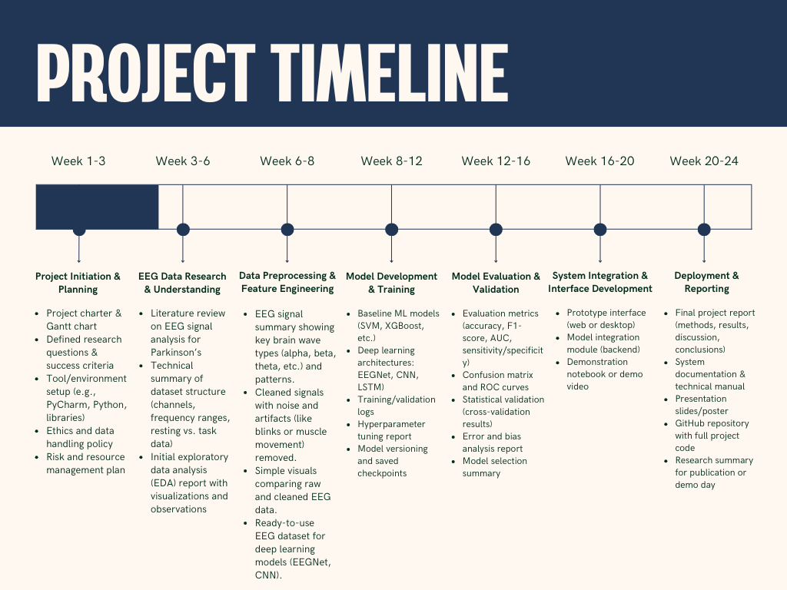
Project Timeline :

Slide 4
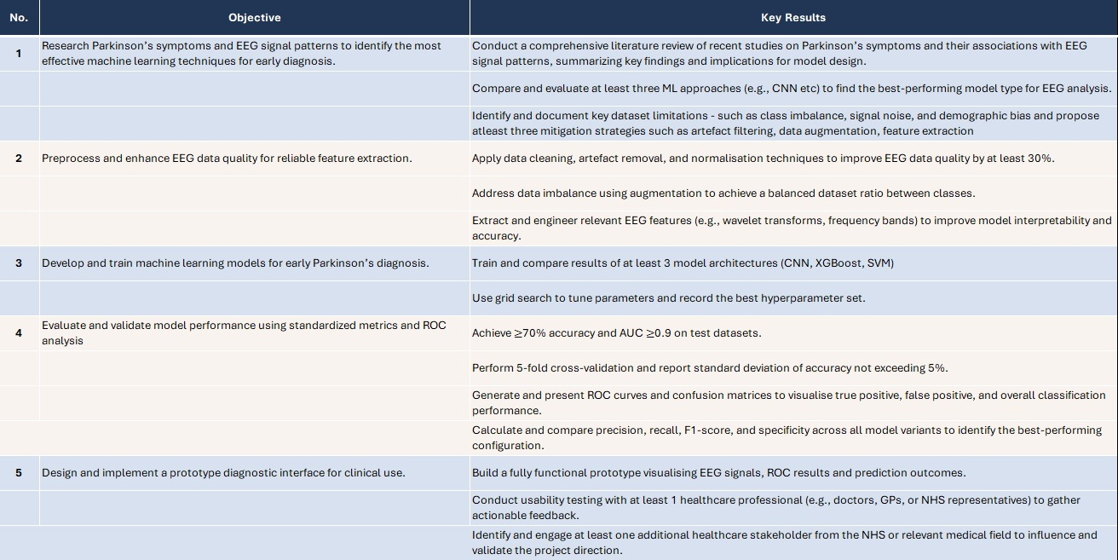
Objective Key Results:

Slide 5
Thank You

